Slide 1
Regression Analysis
Multiple Linear Regression
Nicoleta Serban, Ph.D.
Professor
School of Industrial and Systems Engineering
Predicting Demand for Rental Bikes: Exploratory Data Analysis

Slide 2

About This Lesson

Slide 3
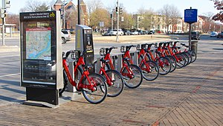
Predicting Demand for Rental Bikes
Bike sharing systems are of great interest due to their important role in traffic management.
Dataset: Historical data for years 2011-2012 for the bike sharing system in Washington D.C.
Data Source: UCI Machine Learning Repository
Acknowledgement: This example was prepared with support from students in the
Masters of Analytics program, including Naman Arora, Puneeth Banisetti,
Mani Chandana Chalasani, Joseph (Mike) Tritchler and Kevin West

Slide 4
Response & Predicting Variables
The response variable is:
Y (Cnt): Total bikes rented by both casual & registered users together
The qualitative predicting variables are:
Season: Season which the observation is made (1 = Winter, 2 = Spring, 3 = Summer, 4 = Fall)
Yr: Year on which the observation is made
Mnth: Month on which the observation is made
Hr: Day on which the observation is made (0 through 23)
Holiday: Indictor of a public holiday or not (1 = public holiday, 0 = not a public holiday)
Weekday: Day of week (0 through 6)
Weathersit: Weather condition (1 = Clear, Few clouds, Partly cloudy, Partly cloudy, 2 = Mist & Cloudy, Mist & Broken clouds, Mist & Few clouds, Mist, 3 = Snow, Rain, Thunderstorm & Scattered clouds, Ice Pallets & Fog)
The quantitative predicting variables are:
Temp: Normalized temperature in Celsius
Atemp: Normalized feeling temperature in Celsius
Hum: Normalized humidity
Windspeed: Normalized wind speed

Slide 5
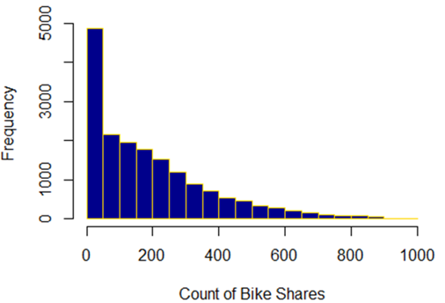
Exploratory Data Analysis in R
## Read data using read.csv
data<-read.csv(“Bikes.csv")
dim(data)[1] # how many observations?
[1] 17379
## Test initial intuitions/assumptions on the behavior of the data
hist(data$cnt,
main="",
xlab="Count of Bike Shares",
border="gold",
col="darkblue")
The frequency of zero bike shares is high, which skews the demand data.

Slide 6
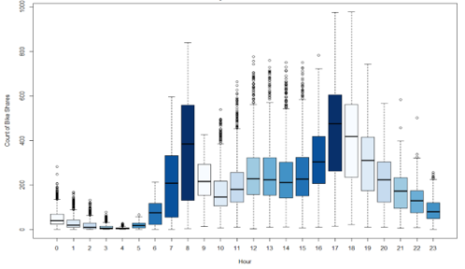
Exploratory Data Analysis in R (cont’d)
## Evaluate intuitions/assumptions on the behavior of the data and understand patterns
boxplot(cnt~hr,
main="",
xlab="Hour",
ylab="Count of Bike Shares",
col=blues9,
data=data)
The number of bike shares between hour 0 and hour 6 is low. The majority activity as expected is focused between hour 7 and hour 23, peaking at hour 8 and hour 17.

Slide 7
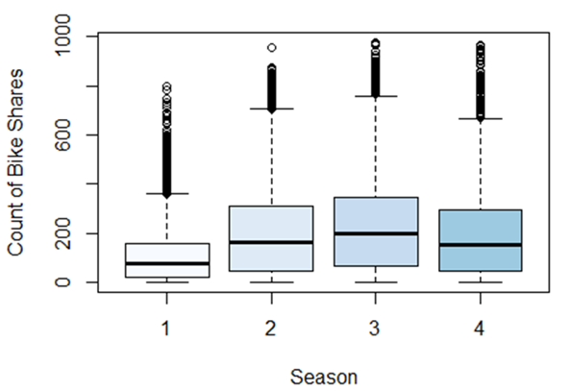
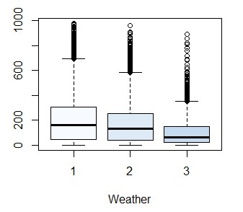
Exploratory Data Analysis in R (cont’d)
The number of bikes rented during winter are the lowest.
The number of bikes decreases as the weather becomes unfavorable.

Slide 8
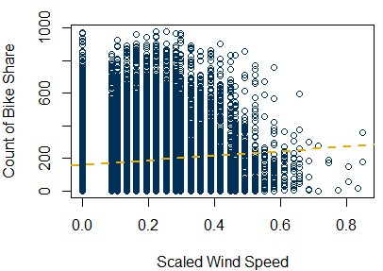
Exploratory Data Analysis in R (cont’d)
plot(data$windspeed,
data$cnt,
xlab='Scaled Wind Speed',
ylab='Count of Bike Share',
main=‘’, col="darkblue")
abline(lm(cnt~windspeed, data=data),
col=buzzgold,
lty=2, lwd=2)
The count of rental bikes seems to decrease as windspeed increases.

Slide 9
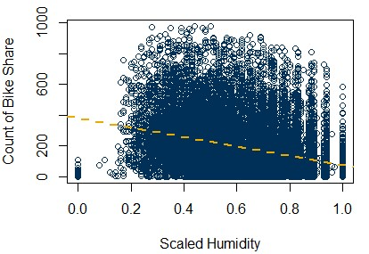
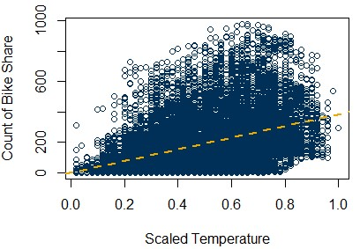
Exploratory Data Analysis in R (cont’d)
The count of rental bikes seems to decrease as humidity increases although the demand varies within similar ranges at varying humidity levels.
The count of rental bikes seems to increase as temperature increases however with much wider variability at larger temperature levels.

Slide 10
Preparing the Data
## Divide data into train and test data
# Set seed for reproducibility
set.seed(9)
# Test Train split
sample_size = floor(0.8*nrow(data))
picked = sample(seq_len(nrow(data)),size = sample_size)
# Remove irrelevant columns from training data
train = data[picked,]
train <- train[-c(1,2,9,15,16)]
## Converting the numerical cateogrical variables to predictors
train$season = as.factor(train$season)
train$yr = as.factor(train$yr)
train$mnth = as.factor(train$mnth)
train$hr = as.factor(train$hr)
train$holiday = as.factor(train$holiday)
train$weekday = as.factor(train$weekday)
train$weathersit = as.factor(train$weathersit)

Slide 11
Fitting the Regression Model
 | Estimate | Std. Error | t value | Pr(>|t|)
(Intercept) | -79.4356 | 7.4390 | -10.678 | < 2e-16 ***
season2 | 34.9268 | 5.4110 | 6.455 | 1.12e-10 ***
season3 | 27.0055 | 6.4438 | 4.191 | 2.80e-05 ***
season4 | 65.3435 | 5.4690 | 11.948 | < 2e-16 ***
yr1 | 85.3415 | 1.7487 | 48.804 | < 2e-16 ***
mnth2 | 4.1666 | 4.3853 | 0.950 | 0.342060
mnth3 | 16.4733 | 4.9267 | 3.344 | 0.000829***
mnth4 | 12.5834 | 7.3038 | 1.723 | 0.084936 .
mnth5 | 26.4616 | 7.8357 | 3.377 | 0.000735 ***
mnth6 | 11.5056 | 8.0535 | 1.429 | 0.153131
mnth7 | -7.8872 | 9.0547 | -0.871 | 0.383736
# Applying multiple linear regression model
model1 = lm(cnt ~ .,data=train)
summary(model1)
In the full output there are 51 predictor rows in addition to the intercept.
⋮
---

Slide 12
Statistical Significance
# Applying multiple linear regression model
model1 = lm(cnt ~ .,data=train)
summary(model1)
# Find insignificant values
which(summary(model1)$coeff[,4]>0.05)
mnth2 | mnth4 | mnth6 | mnth7 | mnth8 | mnth11 | mnth12
6 | 8 | 10 | 11 | 12 | 15 | 16
Statistically insignificant variables at 0.05 significance level:
Month-2, month-4, month-6, month-7, month-8, month-11, month-12 are not statistically different from month-1 (baseline)

Slide 13

Summary

